Slide 2
Hi there! My name is Jen Aranyi (JEN uh-RAHN-ee) and I am a watercolor nature artist and graphic designer. My artwork is heavily influenced by nature and the world around us. I am drawn to bright colors and often create work with vibrant pops of color which contrast with simplified black and white line art. My work predominately features landscapes and nature scenery, and often incorporates colorful night skies dotted with stars and constellations. My art can be found on most social media platforms, and has inspired art teachers around the globe to create lessons based on my work for students as young as 5 years old.
I love being outdoors, and try to go hiking (or at least walking on a trail through the woods) just about every weekend. If I’m not drawing, painting, or off getting lost in the woods somewhere, I’m likely dancing around my living room listening to music, or singing and playing ukulele.

Slide 3
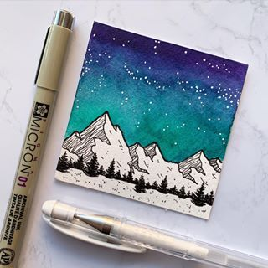
https://jenaranyi.com/

Slide 4
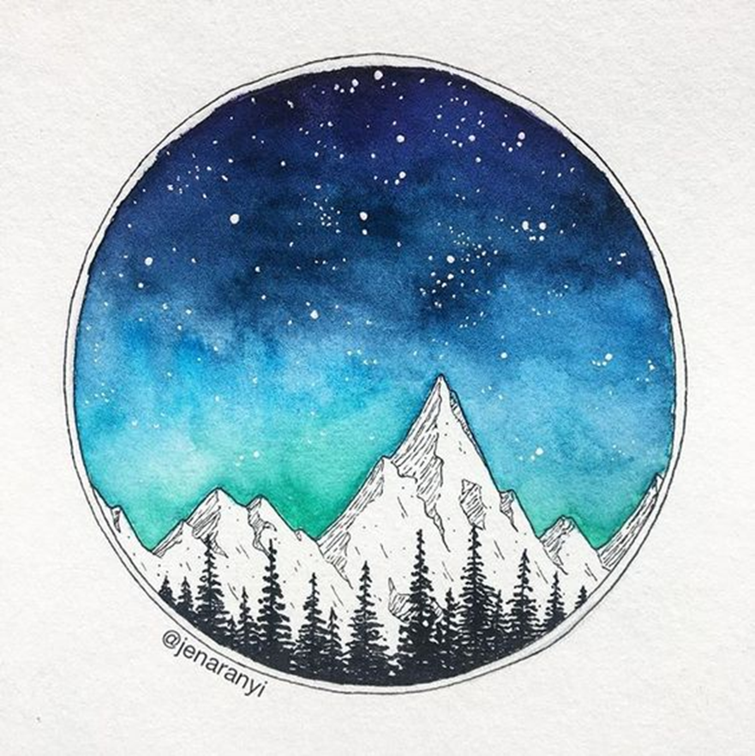
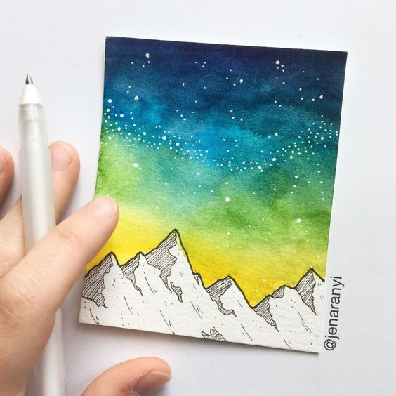

Slide 5
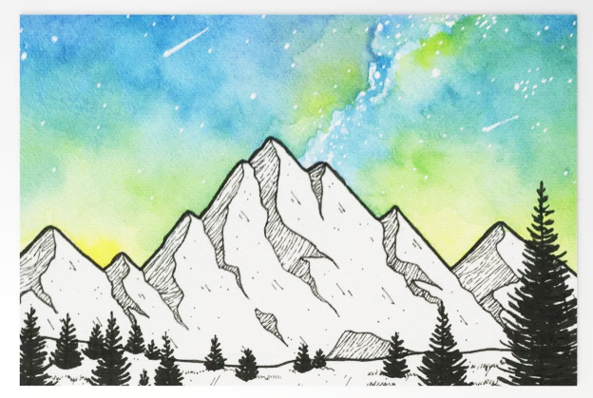

Slide 6
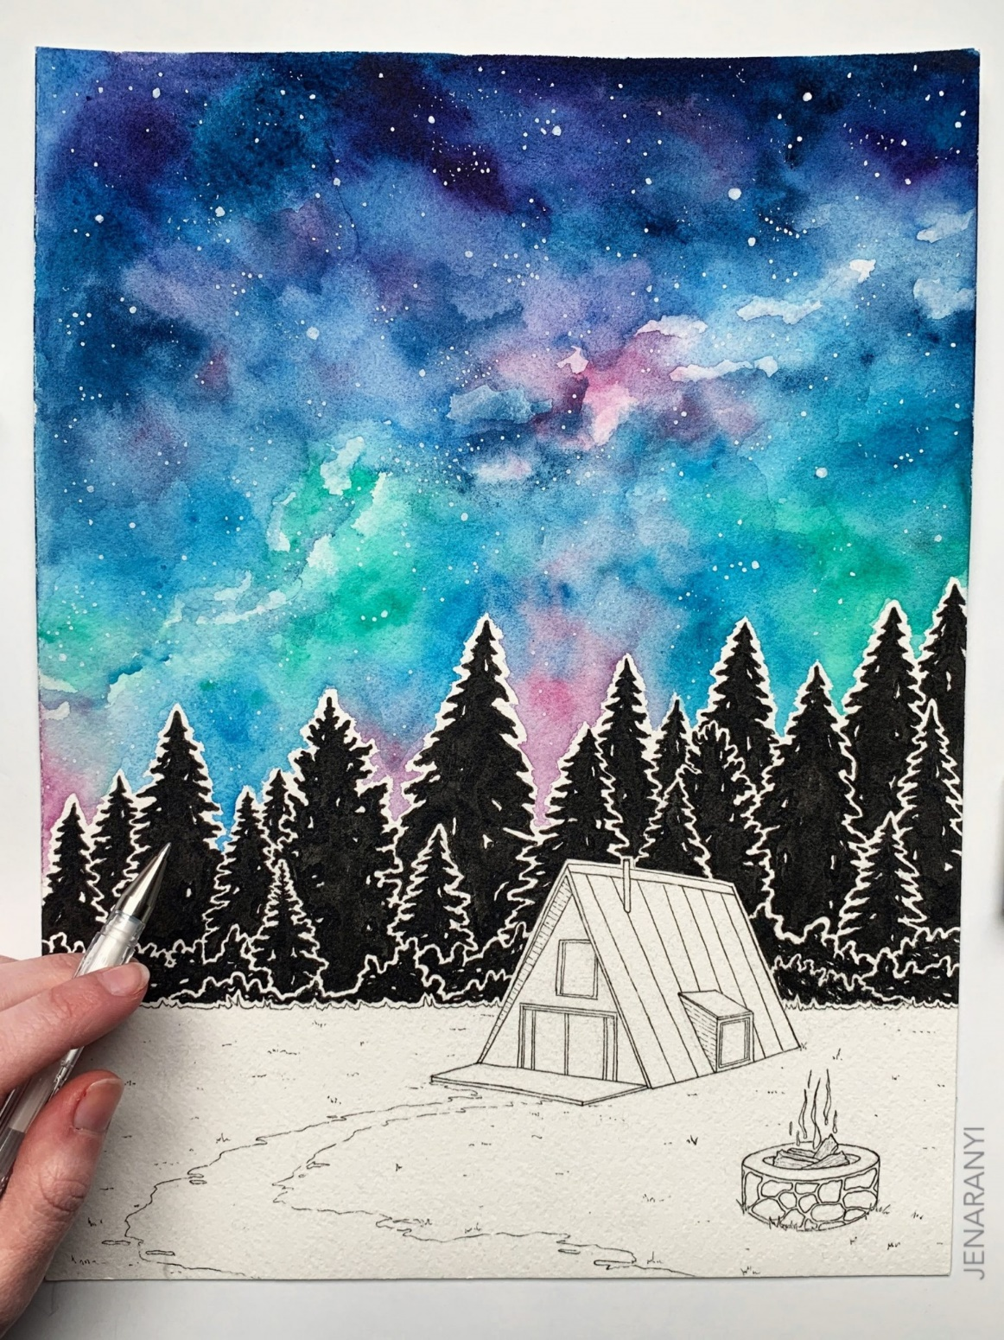
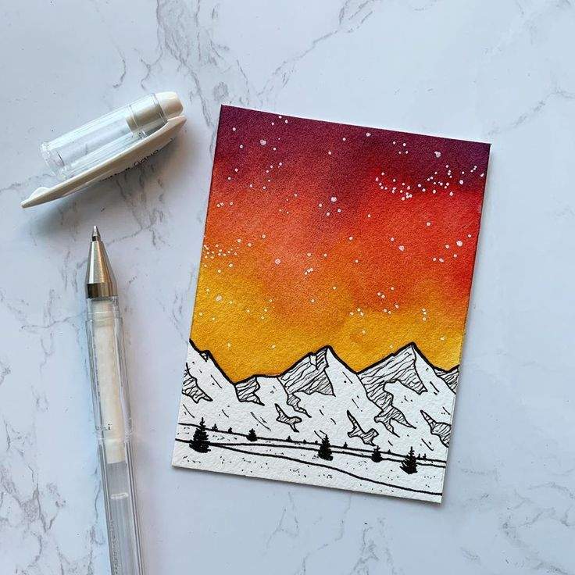

Slide 7
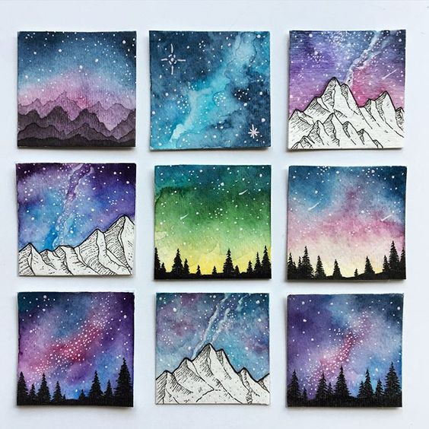

Slide 8
